Slide 1
integration of Mental Health into primary care
The collaborative Care Model
April 2017

Slide 2
Bridging the Divide Between
Mental Health & Medical Care
Mental health MUST be part of overall health
  patients with MH/SUD have 2-3 X times increased total health care costs.
Patient Experience/Reduce Stigma/Improve Access
Answer: Collaborative Care
THE TRIPLE AIM

Slide 3
Integration Efforts
Most models of integrated care are not evidence based
Collaborative Care
Estimated 5-10% reduction of healthcare expenditures
Potential annual savings of $26-48 billion
Potential benefit if using a gain sharing arrangement for psychiatrists
Notes:
Now let’s turn for a moment to the financial and economical effects of collaborative care.
The potential impact of effectively integrated behavioral health care was recently evaluated in a 2014 report that APA commissioned from the actuarial firm Milliman. This report examined large claims data base Medicaid, Medicare, Commercial Insurers to compare the health care costs of patients with mental health & SA disorders compared to those without such disorders. It turns out that patients with MH/SUD have 2-3 times higher total health care costs. Many of these costs relate to ER and inpatient care for MEDICAL conditions.
This report concluded that as much as $26-48 billion could be saved annually if mental disorders were effectively treated through Integrated Behavioral Health Care.

Slide 4





Collaborative Care PRINCIPLES:
Good For ANY Practice
Population-Based Care
Measurement-Based Treatment to Target
Patient-Centered Collaboration
Evidence-Based Care
Accountable Care
Principles: © University of Washington
Notes:
We need to say this early and say this often – the collaborative care we are going to describe meets the triple aim – and that is why CMS has given millions to the partnership of APA and others to focus on this as part of the way to transform clinical practices for the better: the APA has partnered with the AIMS center at UW because this is ground zero of this work on addressing the dramatic work force disconnect, the challenge of providing good BH care in a busy “medical home”

Slide 5
The Collaborative Care Model
Caseload-focused psychiatric consultation supported by a BHP or care manager
Shaping over time
Better access
PCPs get input on their patients’ behavioral health problems within days/weeks versus months
Regular Communication
Psychiatrist provides input on 10 – 20 patients in a half day as opposed to 3-4 patients
Reviews all patients who are not improving and makes treatment recommendations
More patients covered by one psychiatrist
Psychiatrist has regular (weekly) meetings with a BHP/care manager
Multiple brief consultations
More opportunity to ‘correct the course’ if patients are not improving
Focuses in-person visits on the most challenging patients
Notes:
NARRATION:
Collaborative Care was developed to address mental health needs on a population scale. In this model, a caseload of patients is followed by a behavioral health provider and a primary care provider who are located in a primary care setting. Behavioral health providers are typically midlevel providers, such as masters-level social workers, masters in psychology, or registered nurses. In this model, the psychiatric consultant provides consultation to this panel of patients typically indirectly and only directly evaluates a small number of patients. We will be spending a lot of time talking about this model as this is the foundation for the rest of the modules that we will be presenting. So, to highlight just a few of the advantages of this model: Collaborative Care has a strong evidence base and has been shown in studies to provide better access. Primary Care Providers get input on their patients’ behavioral health problems within days to a week versus months. Collaborative Care also focuses on in-person visits when the psychiatrist does need to be involved in the most challenging patients or patients that haven’t been able to be served by the indirect consultation. This model emphasizes a formal structure and practice change which allows for regular communication between the providers. Typically the psychiatric consultant will have regular weekly meetings with the behavioral health provider. The psychiatric consultant will review all patients who are not improving and make treatment recommendations on the caseload of patients. In general, this ability to leverage the psychiatric consultant by the use of a whole team of providers allows more patients to be covered by one psychiatrist. Typically a psychiatrist can provide input on 10-20 patients in a half day as opposed to 3-4 patients if the psychiatrist were in a co-located or traditional consultation role. Lastly, and most importantly for patient care and improved patient outcomes, this kind of formal program using a team allows the psychiatrist to help shape care over time, allowing for multiple brief consultations and more opportunity to correct the course if patients are not improving in order to achieve the ultimate goal of improved patient outcomes.

Slide 6




Collaborative Care is an evidence-based solution that can increase access
Traditional Model
Collaborative Care Model
Psychiatrist
Psychiatrist
(Part-Time)
PCP
PCP
?
Care
Manager
?
Telepsychiatry
Patients
Patients

Slide 7
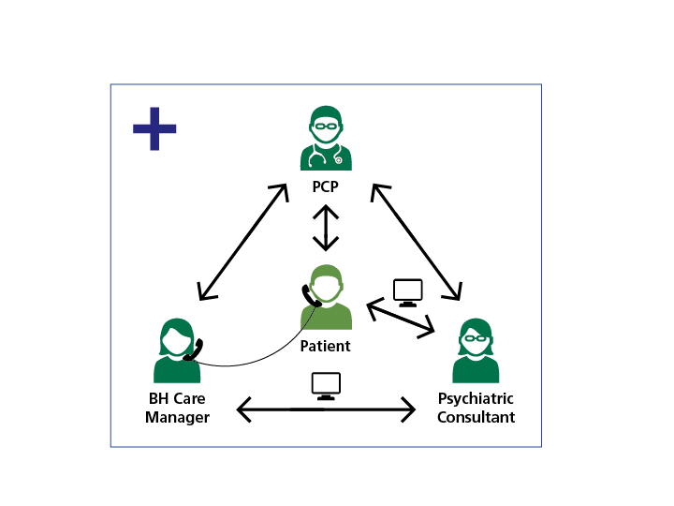
Centralized Care Manger Supporting Multiple Small Practices
Patient
Patient
Patient
Patient
Notes:
We know that many smaller PCP offices do not ha ve a staff person that can do the care manager role, notr can they afford to hire one.
However, thismodel has also been proven to work where you have one BH care manager working with multiple PCP offices and one psychiatric consultant

Slide 8
“Sweet” Spot for the Collaborative Care Model
None
Mild
Moderate
Target Population
Severe
Issues with depression and substance abuse must be pre-empted, rather than treated once advanced.
Goal is to detect early and apply early interventions to prevent from getting more severe
Notes:
This model is focused on early intervention and continued treatment in Primary care. You can see the targeted sweet spot for treatment of the illnesses, which prevents patients from getting sicker and sicker and needing higher levels of care.

Slide 9
Evidence Base
79 randomized controlled trials
  24,308 enrolled patients
Compared to usual care (screening, referral etc.)
  ↑ Response and remission rates
  ↑ Quality of life
  ↑ Patient satisfaction
  ↓ Costs over the long run
Results are consistent across populations
  Stages of life
    Adolescents → Adults → Older Adults
  Minorities
  Diagnoses
    Depression, Anxiety, SUD
Effective integration has the potential to save $26.3-$48.3 billion in overall healthcare spending
  Melek, S., D.T. Norris, and J. Paulus, Economic Impact of Integrated Medical-Behavioral Healthcare. Milliman, 2014.
Notes:
There are 79 randomized control studies about this model.
Results are consistent across populations and compared to usual care, as you can see here it increases patient response rates, satisfaction, quality of life and decreases costs for the system

Slide 10
TEAMcare Outcomes
Depression
HbA1c
SBP
LDL

All Improved!
COST SAVINGS: $600 - $1,100 per patient
Notes:
NARRATION:
This was also a randomized trial, and patients who were randomly assigned to collaborative care had better health outcomes across the board.
Collaborative care patients also had cost savings of about $ 1,000 / patient.
This shows again that collaborative care, if well implemented, can improve access to care, health outcomes, and lower total health care cost: the triple aim of health care reform.

Slide 11
Making the ‘business case’ for integrated care
Improved patient outcomes
Savings in total health care costs
  Demonstrated in research (IMPACT, Pathways)
  Demonstrated in real world evaluations (Kaiser Permanente, Intermountain)
Improved patient and provider satisfaction
Improved provider productivity
  PCPs have shorter, more productive primary care visits = more visits
  Mental health consultants in primary care have lower no-show rates
Improved productivity
  Reduced absenteeism and presenteeism
  Higher incomes / net worth
In safety net populations
  Reduced homelessness and arrest rates
Notes:
NARRATION
In most cases there will need to be both organizational buy in and a funding plan to move towards Collaborative Care. This slide lists several of the most common arguments for why an organization should consider implementation of Collaborative Care. Depending on your audience some benefits may be more meaningful. For healthcare providers, both primary care providers and behavioral health providers, often the most engaging argument for change involves talking to them about the patient experience and how engaging in changing the way they deliver care will help them to deliver the highest quality care to their patients.
Additional details about the business case is often an important selling point for the leadership or administration in a clinic.
Collaborative Care has been demonstrated to achieve the triple aim of improved outcomes, cost savings, and improved satisfaction. Data explaining these benefits and additional evidence related to improved provider productivity, improved overall productivity of the patients, and potentially reducing homelessness and arrest rates for safety net populations with Collaborative Care are all important topics to understand if you will be helping to make the argument for Collaborative Care. The additional resources section for this module provides more detailed materials to support these arguments for making the business case for integrated care.

Slide 12
Payment

Slide 13
Collaborative Care is Reimbursable beginning in 2017
3 Key Elements
Active treatment and care management using established protocols for an identified patient population;
Use of a patient tracking tool to promote regular, proactive outcome monitoring and treatment-to-target using validated and quantifiable clinical rating scales; and
Regular (typically weekly) systematic psychiatric caseload reviews and consultation by a psychiatric consultant, working in collaboration with the behavioral health care manager and primary care team. These primarily focus on patients who are new to the caseload or not showing expected clinical improvement.

Slide 14
CCM codes
Payment goes to the PCP who bills the service
Billed on a per patient basis for those that have met the established time thresholds
The psychiatrist does not bill separately.
  contract with the PCP practice
The patient must provide general consent for the service and they will have a co-pay
Interaction does not have to be face-to-face
Care manager and psychiatrists can also bill additional codes for therapy etc.

Slide 15
99492/99493/99494
*Includes the payment for the time and effort of all three members of the team - the PCP, the BHCM and the consulting psychiatrist
99492: Initial psychiatric collaborative care management, first 70 minutes in the first calendar month of behavioral health care manger activities (billable at 36 minutes)
99493: Subsequent psychiatric collaborative care management, first 60 minutes in subsequent calendar month of behavioral health care manager activities (billable at 31 minutes)
99494: Initial or subsequent psych collaborative care management - each additional 30 min

