Slide 1
APA Practice guideline for the treatment of patients with eating disorders
These training slides are funded by the Gordon and Betty Moore Foundation through a grant program administered by the Council of Medical Specialty Societies.
Notes:
Full practice guideline citation: American Psychiatric Association: Practice Guideline for the Treatment of Patients with Eating Disorders, 4th Ed. Washington, DC, American Psychiatric Association Publishing, 2023
Online and pdf versions available at: https://www.psychiatry.org/psychiatrists/practice/clinical-practice-guidelines
Executive Summary available at: https://ajp.psychiatryonline.org/doi/10.1176/appi.ajp.23180001

Slide 2
Practice Guideline Development
Systematic Review
Writing Group Develops Draft
Review and Revisions
APA Assembly and Board of Trustees Approval
Expert Survey

Slide 3
EATING DISORDERS: Screening
Statement 1 - APA recommends (1C) screening for the presence of an eating disorder as part of an initial psychiatric evaluation.
Rationale: Risk to health if present; estimated prevalence:
Prevalence rates have a wide range of estimates based on the study design and country. Rates for eating disorders that do not meet full diagnostic criteria are even higher.
 | 12-month prevalence | Lifetime prevalence
Anorexia nervosa | 0.5% ♀ 0.1% ♂ | 1.4% ♀ 0.2% ♂
Bulimia nervosa | 0.7% ♀ 0.4% ♂ | 1.9% ♀ 0.6% ♂
Binge-eating disorder | 1.4% ♀ 0.6% ♂ | 2.8% ♀ 1.0% ♂

Slide 4
EATING DISORDERS: SCREENING Questionnaire
Basic questions to integrate into the interview
“Have you or others worried about your weight or shape or about what or how you eat?”
“Has your weight or shape ever affected how you feel about yourself?”
SCOFF Questionnaire
Do you make yourself Sick because you feel uncomfortably full?
Do you worry you have lost Control over how much you eat?
Have you recently lost > 14 lbs (One stone) in a 3-month period?
Do you believe yourself to be Fat when others say you are too thin?
Would you say that Food dominates your life?
  To assess for binge-eating disorder, add: During the last 3 months, did you have any episodes of excessive overeating (i.e., eating significantly more than what most people would eat in a similar period of time)?

Slide 5
EATING DISORDERS: Initial Evaluation of Eating History
Statement 2 - APA recommends (1C) that the initial evaluation of a patient with a possible eating disorder include assessment of
the patient's height and weight history (e.g., maximum and minimum weight, recent weight changes);
presence of, patterns in, and changes in restrictive eating, food avoidance, binge eating, and other eating-related behaviors (e.g., rumination, regurgitation, chewing and spitting);
patterns and changes in food repertoire (e.g., breadth of food variety, narrowing or elimination of food groups);
presence of, patterns in, and changes in compensatory and other weight control behaviors, including dietary restriction, compulsive or driven exercise, purging behaviors (e.g., laxative use, self-induced vomiting), and use of medication to manipulate weight;

Slide 6
EATING DISORDERS: Initial Evaluation of Eating History, cont.
Statement 2 (continued)
percentage of time preoccupied with food, weight, and body shape;
prior treatment and response to treatment for an eating disorder;
psychosocial impairment secondary to eating or body image concerns or behaviors; and
family history of eating disorders, other psychiatric illnesses, and other medical conditions (e.g., obesity, inflammatory bowel disease, diabetes mellitus).

Slide 7
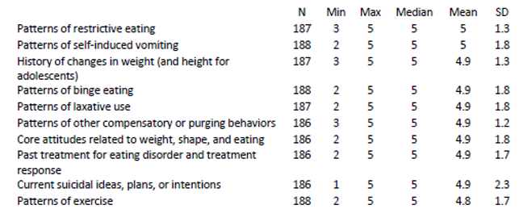
EATING DISORDERS: ASSESSMENT recommendations from expert survey
Rationale for assessment related recommendations comes from consensus, including expert opinion survey (1 = not appropriate, 5 = highly appropriate to assess).

Slide 8
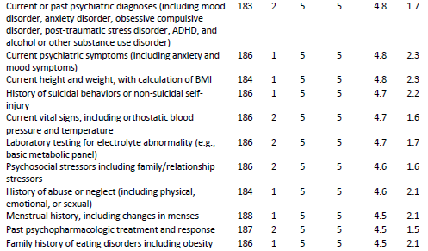
EATING DISORDERS: ASSESSMENT recommendations from expert survey, part 2

Slide 9
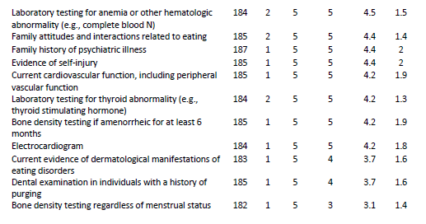
EATING DISORDERS: ASSESSMENT recommendations from expert survey, part 3

Slide 10
EATING DISORDERS: Initial Evaluation
When conducting an assessment for an eating disorder, consider the full range of possible disorders including atypical eating disorders and avoidant/restrictive food intake disorder (ARFID).
ARFID Diagnostic Criteria (F50.82)
An eating or feeding disturbance (e.g., apparent lack of interest in eating or food; avoidance based on the sensory characteristics of food; concern about aversive consequences of eating) associated with one (or more) of the following:
  Significant weight loss (or failure to achieve expected weight gain or faltering growth in children).
  Significant nutritional deficiency.
  Dependence on enteral feeding or oral nutritional supplements.
  Marked interference with psychosocial functioning.
The disturbance is not better explained by lack of available food or by an associated culturally sanctioned practice.
The eating disturbance does not occur exclusively during the course of anorexia nervosa or bulimia nervosa, and there is no evidence of a disturbance in the way in which one’s body weight or shape is experienced.
The eating disturbance is not attributable to a concurrent medical condition or not better explained by another mental disorder. When the eating disturbance occurs in the context of another condition or disorder, the severity of the eating disturbance exceeds that routinely associated with the condition or disorder and warrants additional clinical attention.
Notes:
American Psychiatric Association: Diagnostic and Statistical Manual of Mental Disorders, 5th Ed. Text Revision. Washington DC, American Psychiatric Association, 2022

Slide 11
EATING DISORDERS: Quantitative Measures
Statement 3 - APA recommends (1C) that the initial psychiatric evaluation of a patient with a possible eating disorder include weighing the patient and quantifying eating and weight control behaviors (e.g., frequency, intensity, or time spent on dietary restriction, binge eating, purging, exercise, and other compensatory behaviors).
Rationale:
Establishes level of severity, in part aligning with DSM criteria.
Permits tracking of relative changes in symptoms over time with greater reliability than retrospective recall.
Consistent with suggestion in psychiatric evaluation guidelines and other guidelines to use quantitative measures.

Slide 12
EATING DISORDERS: Examples of Patient and clinician rated Scales
SCOFF Questionnaire
Eating Disorder Assessment for DSM-5 (EDA-5)
Eating Disorders Examination (EDE)
Eating Disorders Examination Questionnaire (EDE-Q)
Eating Disorders 15 (ED-15)
Clinical Impairment Assessment (CIA)
Kids’ Eating Disorders Survey
Eating Disorders in Youth Questionnaire
Nine Item Avoidant/Restrictive Food Intake Disorder Screen
Pica, ARFID, and Rumination Disorder Interview (PARDI)

Slide 13
EATING DISORDERS: Identification of Co-occurring Conditions
Statement 4 - APA recommends (1C) that the initial psychiatric evaluation of a patient with a possible eating disorder identify co-occurring health conditions, including co-occurring psychiatric disorders.
Rationale:
Physical health conditions can confound diagnosis, be associated with higher rates of eating disorders, and contribute to complications of eating disorders.
Rates of psychiatric comorbidity are high (e.g., depression, anxiety, trauma-related disorders, ADHD, misuse of substances such as stimulants).

Slide 14
EATING DISORDERS: Identification of Co-occurring Conditions, part 2
Co-occurring health conditions may be...
a sequela of an eating disorder (e.g., gastroesophageal reflux disease, irritable bowel syndrome, gastroparesis, other GI motility disorders).
complications of eating disorders (e.g., diabetes, inflammatory bowel disease, celiac disease).
When another psychiatric condition is present,
determine whether psychiatric symptoms (depression, anxiety, obsessionality) reflect an independent co-occurring disorder or have developed as a result of the eating disorder.
ARFID is commonly comorbid with…
GI disease (e.g., achalasia, eosinophilic esophagitis, celiac disease, inflammatory bowel disease), autism spectrum disorder, ADHD, anxiety symptoms and diagnoses, and depressive symptoms.

Slide 15
EATING DISORDERS: Identification of Co-occurring Conditions, part 3
Substance use history such as…
the use of caffeine, tobacco, alcohol, cannabinoids, and other substances
cigarette smoking (including electronic cigarettes or vaping) to suppress appetite
the use or misuse of prescribed or non-prescribed medications that suppress appetite (e.g., OTC weight loss products, stimulants) or enhance muscularity (e.g., supplements, androgens)
Trauma history such as…
physical, emotional, or sexual abuse; bullying (including cyberbullying); neglect (including food insecurity); symptoms related to PTSD
Suicide risk assessment such as…
suicide risk, including current suicidal ideas, plans, or intentions, prior suicidal plans or attempts, and the presence of non-suicidal self-injury

Slide 16
EATING DISORDERS: Initial Review of Systems
Statement 5 - APA recommends (1C) that the initial psychiatric evaluation of a patient with a possible eating disorder include a comprehensive review of systems.
Rationale:
Somatic symptoms are common in individuals with eating disorders.
Physical health complications of eating disorders often warrant additional intervention or monitoring.

Slide 17
EATING DISORDERS: Signs and symptoms
Organ System | Symptom/Sign Related to nutritional restriction | Symptom/Sign Related to purging
Whole body | Low body weight, cachexia
Whole body | Fatigue
Whole body | Weakness | Weakness
Whole body | Dehydration
Whole body | Cold intolerance, low body temperature
Whole body | Hot flashes, sweating
Central nervous system | Anxiety, depression, or irritability | Anxiety, depression, or irritability
Central nervous system | Apathy | Apathy
Central nervous system | Poor concentration | Poor concentration
Central nervous system | Headache | Headache
Central nervous system | Seizures (in severe cases) | Seizures (in severe cases)
Central nervous system |  | Paresthesia (due to electrolyte abnormalities)
Central nervous system | Peripheral polyneuropathy (in severe cases)

Slide 18
EATING DISORDERS: Signs and symptoms, part 2
Organ System | Symptom/Sign Related to nutritional restriction | Symptom/Sign Related to purging
Oropharyngeal | Dysphagia
Oropharyngeal |  | Dental enamel erosion and decay
Oropharyngeal |  | Enlarged salivary glands
Oropharyngeal |  | Pharyngeal pain
Oropharyngeal |  | Palatal scratches, erythema, or petechiae
Gastrointestinal | Abdominal discomfort | Abdominal discomfort
Gastrointestinal | Constipation | Constipation
Gastrointestinal |  | Diarrhea (due to laxative use)
Gastrointestinal | Nausea
Gastrointestinal | Early satiety
Gastrointestinal | Abdominal distention, bloating | Abdominal distention, bloating
Gastrointestinal |  | Heartburn, gastroesophageal erosions or inflammation
Gastrointestinal |  | Vomiting, possibly blood-streaked
Gastrointestinal |  | Rectal prolapse

Slide 19
EATING DISORDERS: Signs and symptoms, part 3
Organ System | Symptom/Sign Related to nutritional restriction | Symptom/Sign Related to purging
Cardiovascular | Dizziness, faintness, orthostatic hypotension | Dizziness, faintness, orthostatic hypotension
Cardiovascular | Palpitations, arrhythmias | Palpitations, arrhythmias
Cardiovascular | Bradycardia
Cardiovascular | Weak irregular pulse
Cardiovascular | Cold extremities, acrocyanosis
Cardiovascular | Chest pain
Cardiovascular | Dyspnea
Reproductive | Slowing of growth (in children or adolescents) | Slowing of growth (in children or adolescents)
Reproductive | Arrested development of secondary sex characteristics | Arrested development of secondary sex characteristics
Reproductive | Low libido | Low libido
Reproductive | Fertility problems
Reproductive | Oligomenorrhea | Oligomenorrhea
Reproductive | Primary or secondary amenorrhea

Slide 20
EATING DISORDERS: Signs and symptoms, part 4
Organ System | Symptom/Sign Related to nutritional restriction | Symptom/Sign Related to purging
Muscular | Proximal muscle weakness, wasting, or atrophy
Muscular |  | Muscle cramping
Skeletal | Bone pain | Bone pain
Skeletal | Stress fractures | Stress fractures
Skeletal | Slowed growth (relative to expected) | Slowed growth (relative to expected)
Dermatological | Dry, yellow skin
Dermatological | Change in hair including hair loss and dry and brittle hair
Dermatological | Lanugo
Dermatological |  | Scarring on dorsum of hand (Russell's sign)
Dermatological | Poor skin turgor | Poor skin turgor
Dermatological | Pitting edema (with refeeding) | Pitting edema

Slide 21
EATING DISORDERS: Initial Physical Examination
Statement 6 - APA recommends (1C) that the initial physical examination of a patient with a possible eating disorder include assessment of vital signs, including temperature, resting heart rate, blood pressure, orthostatic pulse, and orthostatic blood pressure; height, weight, and BMI (or percent median BMI, BMI percentile, or BMI Z-score for children and adolescents); and physical appearance, including signs of malnutrition or purging behaviors.
Rationale:
Experts suggest that physical examination assessment improves diagnostic accuracy, appropriateness of treatment selection, and treatment safety.

Slide 22
EATING DISORDERS: Physical Examination and other signs
Abnormal vital signs
Height, weight, and BMI
Possible indication of medical instability that warrants a higher-level care, e.g., heart rate < 50 bpm, systolic blood pressure < 90 mmHg, or temperature < 36 °C (96.8 °F)
Evaluate initially and, ideally, obtain weight at all visits. (www.cdc.gov/healthyweight/assessing/bmi/adult_bmi/english_bmi_calculator/bmi_calculator.html)
Note that normal results may not exclude the presence of an eating disorder.

Slide 23
EATING DISORDERS: Physical Examination and other signs (continued)
If purging behavior is present…
- Refer for a dental evaluation.
- Instruct patients not to brush teeth after vomiting.
- Oral rinsing with water after vomiting and avoiding ingestion of carbonated beverages or citrus fruits may help to reduce effects on dentition.

Slide 24
EATING DISORDERS: Initial Laboratory Assessment
Statement 7 - APA recommends (1C) that the laboratory assessment of a patient with a possible eating disorder include a complete blood count and a comprehensive metabolic panel, including electrolytes, liver enzymes, and renal function tests.
Rationale:
Experts suggest that laboratory assessment improves diagnostic accuracy, appropriateness of treatment selection, and treatment safety.
Laboratory assessment can be helpful in detecting abnormalities that may require intervention, including a higher level of care, though, normal laboratory values should not rule out a potential eating disorder.

Slide 25
EATING DISORDERS: laboratory abnormalities
Test | Related to nutritional restriction | Related to purging
Serum electrolytes | Hypokalemia, hyponatremia, hypomagnesemia, hypophosphatemia (especially on refeeding) | Hypokalemia, hyponatremia, hypochloremia, hypomagnesemia, hypophosphatemia, metabolic acidosis
Lipid panel | Hypercholesterolemia
Serum glucose | Low blood sugar
Liver function | Elevated liver function tests
Renal function tests | Increased BUN, decreased GFR, decreased Cr because of low lean body mass (normal creatinine may indicate azotemia), renal failure (rare) | Increased BUN and Cr, renal failure (rare)

Slide 26
EATING DISORDERS: laboratory abnormalities (continued)
Test | Related to nutritional restriction | Related to purging
Urinalysis | Urinary specific gravity abnormalities | Urinary specific gravity abnormalities, high pH
Serum gonadotropins and sex hormones | Decreased serum estrogen or serum testosterone; prepubertal patterns of LH, FSH | May be hypoestrogenemic, if menstrual irregularities are present
Bone densitometry (DXA scan) | Reduced BMD, osteopenia, or osteoporosis in individuals with previous low weight and menstrual irregularity or amenorrhea | Reduced BMD, osteopenia or osteoporosis in individuals with previous low weight and menstrual irregularity or amenorrhea
Dental radiography |  | Erosion of dental enamel

Slide 27
EATING DISORDERS: Examples of Potential laboratory Abnormalities
Anemia, leukopenia, or thrombocytopenia, particularly at low weight
Hemoconcentration from dehydration in individuals who purge or restrict fluids (may initially mask anemia)
Hypoglycemia in the setting of reduced glycogen stores and impaired gluconeogenesis in individuals with AN
Postprandial hypoglycemia in individuals with a low BMI
Hypokalemia and hypochloremic metabolic alkalosis in individuals who vomit regularly; hyperchloremic metabolic acidosis in individuals who misuse laxatives
Hyponatremia in patients with eating disorders who drink excessive amounts of water, which poses a risk for seizures; increased risk with concurrent use of medications that can cause hyponatremia (e.g., SSRIs)

Slide 28
EATING DISORDERS: Initial Electrocardiogram
Statement 8 - APA recommends (1C) that an electrocardiogram be done in patients with a restrictive eating disorder, patients with severe purging behavior, and patients who are taking medications that are known to prolong QTc intervals.
Rationale:
Conducting an electrocardiogram (ECG) under specified circumstances as part of the initial evaluation may improve diagnostic accuracy, appropriateness of treatment selection, and treatment safety.

Slide 29
EATING DISORDERS: ECG for cardiac abnormalities
Test | Related to nutritional restriction | Related to purging
ECG | Bradycardia or arrhythmias, QTc prolongation | Increased P-wave amplitude and duration, increased PR interval, widened QRS complex, QTc prolongation, ST depression, T-wave inversion or flattening, U waves, supraventricular or ventricular tachyarrhythmias

Slide 30
EATING DISORDERS: TREATMENT PLAN, Including Level of Care
Statement 9 - APA recommends (1C) that patients with an eating disorder have a documented, comprehensive, culturally appropriate, and person-centered treatment plan that incorporates medical, psychiatric, psychological, and nutritional expertise, commonly via a coordinated multidisciplinary team.
Rationale:
Having a comprehensive treatment plan assures consideration of nonpharmacological and pharmacological treatment options and assists in forming a therapeutic relationship, eliciting patient preferences, permitting education about possible treatments, setting expectations for treatment, and establishing a framework for shared decision-making.

Slide 31
EATING DISORDERS: Determining an appropriate setting of care
Does the patient have any factors that suggest significant medical instability that would require pediatric or medical admission for monitoring, fluid management (including intravenous fluids), or nutritional supplementation via nasogastric tube feeding?
E.g., HR < 50 bpm, BP < 90/45, significant orthostatic vital sign changes, hypokalemia, hyponatremia, hypomagnesemia, hypophosphatemia, low body temperature (< 96 °F), low BMI (< 15 for adults, < 75% median BMI for adolescents), prolonged QTc (> 450 msec), significant ECG abnormalities, acute complications of malnutrition (e.g., seizures, syncope, cardiac failure, pancreatitis, poorly controlled diabetes, arrested growth and development in adolescents)

Slide 32
EATING DISORDERS: Determining an appropriate setting of care, part 2
Does the patient have co-occurring conditions (e.g., diabetes, substance use disorders, personality disorders) that would significantly affect treatment needs and require a higher level of care?
Has the patient had a trial of outpatient treatment that was unsuccessful?
To what extent is the patient able to control eating disorder and weight control behaviors (e.g., restrictive eating, binge eating, purging)?

Slide 33
EATING DISORDERS: Determining an appropriate setting of care, part 3
Additional Considerations:
What is the patient's level of motivation to recover, including insight and cooperation with treatment?
What is the patient's psychosocial context, including level of environmental and psychosocial stress and ability to access support systems?
To what extent would the patient’s access to a level of care be influenced by logistical factors (e.g., geographical considerations; financial or insurance considerations; access to transportation or housing; school, work, or childcare needs)?

Slide 34
EATING DISORDERS: Characteristics of levels of care
Setting Characteristics
Unit security
Patient legal status
Physician on-site 24/7
Nursing on-site 24/7
Medical monitoring
Hours of operation
Able to maintain work/school
Levels of Care
Specialized pediatric or medical inpatient
General pediatric or medical inpatient
Specialized psychiatric inpatient
General psychiatric
Residential programs
Partial hospital
Intensive outpatient
Outpatient
Variation
in Availability of Features
Interventions
Option for IV hydration, NG tube feedings, or treatment over objection
Medical, psychiatric, or psychological management
Group-based therapies
Individual, family, and group-based psychotherapies
Multidisciplinary team-based management
Meal supervision and support
Milieu therapy
Nutritional management

Slide 35
ANOREXIA NERVOSA : Medical Stabilization, Nutritional Rehabilitation, and Weight Restoration
Statement 10 - APA recommends (1C) that patients with anorexia nervosa who require nutritional rehabilitation and weight restoration have individualized goals set for weekly weight gain and target weight.
Rationale:
Weight restoration is central to recovery and prognosis.
Monitoring of weight is crucial and lack of weight gain indicates a need to modify the treatment plan.

Slide 36
ANOREXIA NERVOSA: Weight restoration
Typical ranges of weekly weight gain vary with the treatment setting.
  Higher level of care is usually needed if no progress after 6 weeks of treatment (e.g., average weight gain of 0.5-1 lb/week in patients with AN).
  Generally, the closer to patient’s target weight before discharge, the less risk of relapse and readmission; also, less risk of relapse likely if patients maintain weight for a period of time before being discharged from inpatient or residential treatment.
Suggested rate of weight gain by level of care | Pounds per week
Outpatient | 1 to 2
Intensive outpatient | 1 to 2
Partial hospital | 1 to 3
Residential | 2 to 4
Inpatient | 2 to 4

Slide 37
ANOREXIA NERVOSA: Weight restoration, cont.
Usually start with 1,500-2,000 kcal/day, rapidly advance to 3,000-4,000 kcal/day divided into meals and snacks and adjust further as needed.
Usual formulas for calculating calorie requirements will typically underestimate caloric needs; patients are hypermetabolic during weight restoration.
Involve registered dieticians in treatment.
Increase dietary variety.
Meal-based nutrition (regularly scheduled and monitored meals and snacks) is preferred over tube feeding.
Calorie dense liquid supplements can be given in between meals.

Slide 38
ANOREXIA NERVOSA: refeeding syndrome
With profound malnutrition, be alert to signs of refeeding syndrome.
Hypophosphatemia occurs relatively frequently and is associated with recent rapid weight loss and a low BMI.
Additional manifestations of refeeding syndrome are much less common but include rhabdomyolysis, seizure, and ultimately severe edema leading to heart failure.
Refeeding syndrome can be prevented by…
continuing adequate nutrition;
examining the patient for signs of heart failure;
monitoring laboratory test values (e.g., glucose and electrolytes including magnesium and phosphorous);
replacing phosphorous orally when clinically indicated.

Slide 39
ANOREXIA NERVOSA: MEDICATIONS
Insufficient evidence to make recommendations about use of medications in weight restoration of AN
Olanzapine
May be useful in selected patients to assist with weight gain.
SSRIs or other antidepressants
Relatively few risks and commonly used in individuals with AN to address co-occurring depression or anxiety disorders.
Consider potential adverse effects of olanzapine.
Available evidence does not suggest an appreciable benefit, either in fostering weight gain in low weight patients or in reducing relapse in those whose weight has been restored.

Slide 40
ANOREXIA NERVOSA: MEDICATIONS, cont.
Bupropion
Problematic for use in individuals with purging behaviors (e.g., laxative use, self-induced vomiting), given the increased risk of seizures observed in early clinical trials of high-dose immediate release bupropion. Purging may be surreptitious in AN.
Other meds
E.g., citalopram, quetiapine, transdermal estradiol, human growth hormone, cisapride.
Small studies with a high risk of bias or no substantial benefits.
Estrogens or bisphosphonates for bone health
Not routinely recommended, even in patients with > 6 months of amenorrhea.

Slide 41
ANOREXIA NERVOSA: Psychotherapy in Adults
Statement 11 - APA recommends (1B) that adults with anorexia nervosa be treated with an eating disorder-focused psychotherapy, which should include normalizing eating and weight control behaviors, restoring weight, and addressing psychological aspects of the disorder (e.g., fear of weight gain, body image disturbance).
Rationale:
Support from the expert opinion survey and from a network meta-analysis (NMA) of studies of psychotherapies in AN
Use of psychotherapy can improve weight-related outcomes including change in BMI, change in weight, or the percent ideal body weight (%IBW) attained.

Slide 42
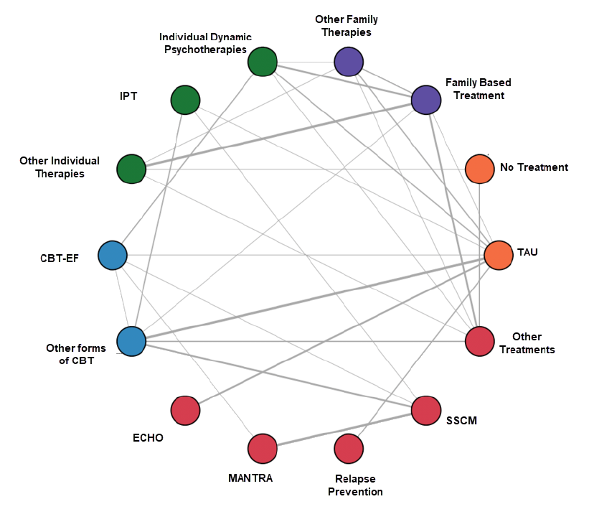
ANOREXIA NERVOSA: network META-ANALYSIS DIAGRAM For PSYCHOTHERAPIES
Notes:
Nodes represent a treatment. Node colors indicate broader groups of the studied interventions. Labels represent included RCTs with direct comparisons for the corresponding edge. Line widths connecting the nodes are proportional to the number of studies that included a specific comparison.
CBT=cognitive-behavioral therapy; CBT-E=enhanced cognitive-behavioral therapy for eating disorders; ECHO=Experienced Caregivers Helping Others; IPT=interpersonal psychotherapy; MANTRA=Maudsley Model of Anorexia Nervosa Treatment for Adults; SSCM=Specialist Supportive Clinical Management; TAU=treatment as usual.

Slide 43
ANOREXIA NERVOSA: nma feasibility and characteristics OF PSYCHOTHERAPY STUDIES
Outcome | Interventions: Total (NMA) | Studies: Total (NMA) | Trials per direct comparison | Subjects per comparison | Total Subjects in NMA
BMI change from baseline | 12 | 17 | 1, except 3 for MANTRA vs. SSCM | 12-134 | 1,426
Weight change from baseline | 8 (6) | 6 (4) | 1 | 14-82 | 307
Percent ideal body weight | 5 | 4 | 1 | 12-82 | 168
Depression change from baseline | 8 | 5 | 1 | 34-128 | N/A
Anxiety change from baseline | 9 | 6 | 1 | 12-128 | N/A
Study withdrawal | 12 | 12 | 1-2 | 12-130 | 950
Mortality | 11 | 6 |  | 20-134 | N/A
Treatment adherence rate | 8 (6) | 5 (4) | 1 | 16-72 | 459
Treatment discontinuation | 9 (6) | 5 (4) | 1 | 16-82 | 354
Disease response, recovery/remission | 10 (7) | 7 (6) | 1, except TAU vs. IndividualDyn with 2 | 15-82 | 688
Hospitalization | 7 | 7 | 1 | 11-82 | 568
Eating disorder scale change | 7 | 8 | 1-3 | 30-134 | 874
Social functioning change | 6 | 5 | 1, except MANTRA vs. SSCM with 2 | 31-130 | N/A
Quality of life | 3 | 3 |  |  | N/A
Notes:
IndividualDyn=Individual dynamic therapies; MANTRA=Maudsley Model of Anorexia Nervosa Treatment for Adults; NMA=network meta-analysis; SSCM=Specialist Supportive Clinical Management; TAU=treatment as usual.

Slide 44
ANOREXIA NERVOSA: Statistically favored comparisons FROM nma
Statistically favorable weight-related outcomes (i.e., BMI/weight change, %IBW) | Compared to No Treatment | Compared to TAU
Eating Disorder Focused CBT (CBT-EF) | ✓ | ✓
Other forms of CBT | ✓
Family-based treatment (with parents in charge of eating) | ✓ | ✓
Other family therapies | ✓
Maudsley Model of Anorexia Nervosa Treatment for Adults (MANTRA) | ✓
Individual dynamic therapies | ✓ | ✓
Experienced Carers Helping Others (ECHO) | ✓
Relapse prevention therapy | ✓
Specialist Supportive Clinical Management (SSCM) | ✓
Other therapies | ✓ | ✓
Treatment as usual (TAU) | ✓

Slide 45
ANOREXIA NERVOSA: PSYCHOTHERAPIES
Psychotherapies with modest efficacy in treating AN in adults
  Cognitive-behavioral therapy (CBT; eating focused and broadly focused)
  Focal psychodynamic psychotherapy (FPT)
  Interpersonal therapy (IPT)
  Maudsley Model of Anorexia Nervosa Treatment for Adults (MANTRA)
  Specialist Supportive Clinical Management (SSCM)
  Experienced Carers Helping Others (ECHO) - aimed at supporting carers of patients with AN but can also contribute to improved outcomes.
Some approaches, such as family-based treatment in adolescents, may be time-limited; however, for individuals with AN of long duration, psychotherapy is frequently required for at least 1 year and may take many years.

Slide 46
ANOREXIA NERVOSA: Components of PSYCHOTHERAPIES
 | CBT-AN | CBT-E | FPT | SSCM | MANTRA | ECHO | AFT | FBT
In-session weighing | ✓ | ✓ |  | ✓ | ✓ |  |  | ✓
Individualized case formulation | ✓ | ✓ | ✓ |  | ✓ |  | ✓ | ✓
Motivational phase of treatment | ✓ | ✓ | ✓ |  | ✓ | ✓ | ✓
Focus on interpersonal issues/emotional expression | ✓ | ✓ | ✓ | ✓ | ✓ | ✓ | ✓ | indirectly
Monitoring of symptoms, including eating | ✓ | ✓ | ✓ | ✓ | ✓ | ✓ | ✓ | ✓
Examining association of symptoms/eating with cognitions | ✓ | ✓
Focus on building activities/passions to minimize overconcern with weight/body shape | ✓ | ✓ |  | If raised by patient |  | ✓ |  | ✓
Use of an experimental mindset to change attitudes and behaviors | ✓ | ✓ |  |  | ✓ |  |  | ✓
Parent-facilitated meal supervision |  |  |  |  |  | ✓ |  | ✓
Notes:
AFT=adolescent focused individual therapy; CBT-AN=cognitive-behavioral therapy for anorexia nervosa; CBT-E=enhanced cognitive-behavioral therapy for eating disorders; ECHO=Experienced Carers Helping Others; FBT=family-based therapy/treatment;
FPT=focal psychodynamic psychotherapy; MANTRA=Maudsley Model of Anorexia Nervosa Treatment for Adults; SSCM=specialist supportive clinical management.

Slide 47
ANOREXIA NERVOSA: Family-Based Treatment in Adolescents and Emerging Adults
Statement 12 - APA recommends (1B) that adolescents and emerging adults with anorexia nervosa who have an involved caregiver be treated with eating disorder-focused family-based treatment, which should include caregiver education aimed at normalizing eating and weight control behaviors and restoring weight.
Rationale:
Support from the expert opinion survey and from an NMA of studies of psychotherapies in AN
FBTs (with family in charge of the patients’ eating) led to greater changes in BMI than no treatment and greater changes in %IBW than TAU.

Slide 48
ANOREXIA NERVOSA: Family-Based Treatment in Adolescents and Emerging Adults
Manual-based approach that considers the effects of severe weight loss as being central to the core psychology of AN
Parents oversee and take responsibility for nourishing the child or adolescent back to an optimal weight range; the therapist acts as knowledge expert and facilitator.
Not limited to family members; could involve other non-family caregivers with whom the patient resides

Slide 49
Anorexia nervosa: CLINICAL EXAMPLE
24-yo female referred by her Gyn due to c/o anxiety and depression.
Reports difficulty with insomnia, reduced concentration, but no change in appetite.
Loss of 15 pounds in the past year. Notes that family was concerned about weight loss, but she felt she was simply eating healthier. Eats ~1,200 calories daily, avoids carbohydrates and red meat, and runs 90-120 min/day.
Has significant demands from graduate school. Manages stress with journaling, baking, and running.
Intermittent self-induced vomiting at age 16, but not since then. Never treated.
Counseling in junior year of college for test anxiety, but no medications.
No alcohol or substance use history.
ROS - constipation, abdominal bloating, no endocrine disorders.
Family history: Type 2 DM and untreated depression in mother, obesity in sister.
Physical exam: 5’5” tall, 100 lbs (BMI 16.6).

Slide 50
Bulimia Nervosa: CBT and SSRI Treatment for adults
Statement 13 - APA recommends (1C) that adults with bulimia nervosa be treated with eating disorder-focused cognitive-behavioral therapy and that a serotonin reuptake inhibitor (e.g., 60 mg fluoxetine daily) also be prescribed, either initially or if there is minimal or no response to psychotherapy alone by 6 weeks of treatment.
Rationale:
CBT showed greater binge-eating and purging abstinence and reductions in the frequencies of binge eating and purging.
CBT in combination with antidepressant medications also showed efficacy on these outcomes and on depression measures.

Slide 51
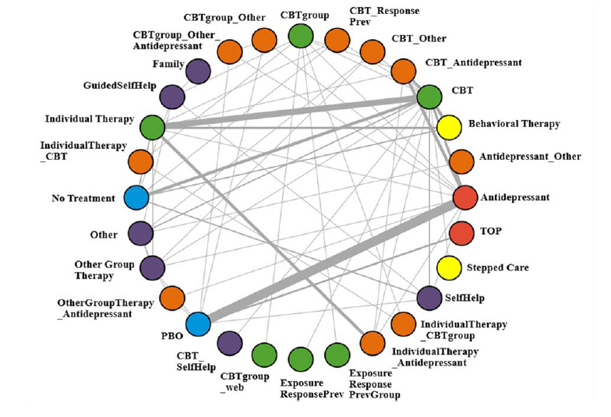
BULIMIA NERVOSA: Network META-ANALYSIS Diagram OF treatments
Notes:
Nodes represent a treatment. Node colors indicate broader groups of the studied interventions. Labels represent included RCTs with direct comparisons for the corresponding edge. Line widths connecting the nodes are proportional to the number of studies that included a specific comparison.
BN=bulimia nervosa; CBT=cognitive-behavioral therapy; PBO=placebo; Prev=prevention; TOP=topiramate.

Slide 52
BULIMIA NERVOSA: nma feasibility and characteristics OF STUDIES
Outcome | Interventions: Total | Studies: Total | Trials per direct comparison | Total Subjects in NMA
BMI change from baseline | 14 | 14 | 1-4 | 1,226
Weight change from baseline | 7 | 8 | 1-4 | 695
Eating disorder scale change from baseline | 17 | 20 | 1-5 | 2,245
Binge-eating abstinence | 17 | 20 | 1-6 | 1,541
Binge-eating frequency change from baseline | 17 | 31 | 1-8 | 2,863
Purging frequency change from baseline | 11 | 11 | 1-5 | 790
Purging abstinence | 6 | 5 | 1-2 | 272
Vomiting frequency change | 17 | 23 | 1-3 | 2,241
Vomiting abstinence | 12 | 10 | 1-2 | 1,003
Study withdrawal | 26 | 21 | 1-7 | 2,528
Treatment discontinuation | 15 | 10 | 1-4 | 1004
Disease response, remission/recovery | 11 | 11 | 1-2 | 1,424
Depression scale change from baseline | 16 | 27 | 1-4 | 2,370
Self-esteem change from baseline | 10 | 9 | 1-3 | 558
Treatment adherence rate | 6 | 2 | 1 | 160

Slide 53
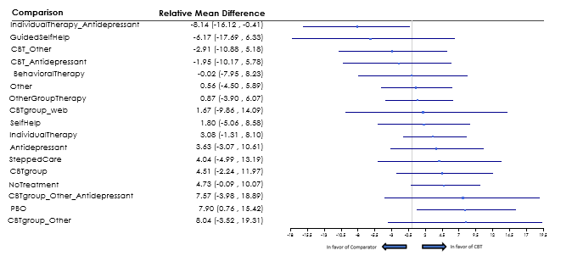
BULIMIA NERVOSA: Forest plot of Change in binge-eating frequency
Change in binge-eating frequency in BN as compared to CBT
Notes:
Statistically significant differences are present for antidepressants compared to CBT and for antidepressants, CBT, and the combination of CBT and antidepressant as compared to placebo (PBO).

Slide 54
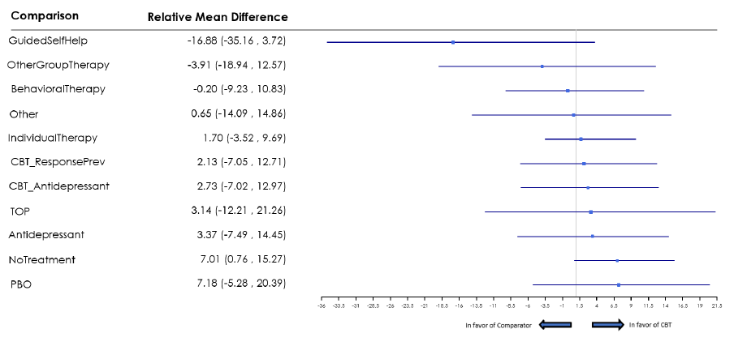
BULIMIA NERVOSA: Forest plot of purging frequency
Purging frequency in BN as compared to CBT
Notes:
Note: Statistically significant differences compared to no treatment are present for CBT and for guided self-help.
PBO=placebo; ResponsePrev=Response prevention; TOP=topiramate.

Slide 55
BULIMIA NERVOSA: Statistically favorable effects by treatment
Intervention | Comparison | Outcomes | Statistical values
Antidepressants | Placebo | Binge-eating abstinence | RR 2.23 (1.47, 4.25)
 | Placebo | Binge-eating frequency, all units | RMD -4.29 (-7.60, -1.07)
 | Placebo | Binge-eating frequency, per week | RMD -3.54 (-5.51, -1.72)
CBT | No Treatment | Binge-eating abstinence | RR 4.97 (1.76, 15.29)
 |  | Purging frequency, all units | RMD -7.01 (-15.27, -0.76)
 |  | Purging abstinence | RR 11.15 (1.87, 132.66)
 | Placebo | Binge-eating abstinence | RR 3.25 (1.37, 10.86)
 |  | Binge-eating frequency, all units | RMD -7.90 (-15.42, -0.76)
 |  | Binge-eating frequency, per week | RMD -7.77 (-12.30, -3.59)
 |  | Study withdrawal | RR 0.29 (0.08, 0.94)
 | Antidepressants | Binge-eating frequency, per week | RMD -4.24 (-8.13, -0.30)
 |  | Study withdrawal | RR 0.25 (0.07, 0.73)
CBT+Antidepressant | No Treatment | Depression scales | RMD -11.74 (-21.90, -1.84)
 | Placebo | Binge-eating abstinence | RR 2.70 (1.01, 7.09)
 |  | Depression scales | RMD -5.52 (-10.58, -0.46)
 |  | Binge-eating frequency, all units | RMD -9.88 (-18.68, -1.75)
 |  | Binge-eating frequency, per week | RMD -8.37 (-14.04, -2.82)
CBT Group | No Treatment | Eating disorder scale | RR -17.47 (-33.02, -2.14)
 |  | Binge-eating abstinence | RR 5.36 (1.02, 26.05)
 |  | Depression scales | RMD -9.96 (-18.74, -1.57)
 | Placebo | Binge-eating abstinence | RR 3.61 (1.02, 14.84)
 |  | Vomiting frequency, all units | RMD -3.06 (-6.04, -0.29)
 |  | Vomiting frequency, per week | RMD -7.02 (-13.85, -0.67)
Notes:
CBT=cognitive-behavioral therapy; RMD=relative mean difference; RR=relative risk.

Slide 56
BULIMIA NERVOSA: CBT and SSRI
Initiating treatment with CBT alone vs. CBT plus an SSRI (e.g., fluoxetine 60 mg/day) will depend on factors such as symptom severity, co-occurring disorders, and patient preferences.
Fluoxetine is a preferrable choice of SSRI based on the greatest strength of efficacy evidence in BN, independent of effects on mood.
Bupropion is contraindicated for use in individuals with BN, given the increased risk of seizures with high-dose immediate-release bupropion.
With lithium, caution is needed to avoid toxicity due to dehydration in patients who vomit or purge using laxatives.

Slide 57
BULIMIA NERVOSA: nutritional intake
Assess nutritional intake for all patients with BN regardless of their body weight or BMI because normal weight does not imply appropriate nutritional intake.
A structured meal plan can be helpful to reduce episodes of dietary restriction and urges to binge and purge.
Nutrition counseling with a registered dietitian nutritionist is often needed to implement the eating plan.

Slide 58
BULIMIA NERVOSA: Family-Based Treatment in Adolescents and Emerging Adults
Statement 14 - APA suggests (2C) that adolescents and emerging adults with bulimia nervosa who have an involved caregiver be treated with eating disorder–focused family-based treatment.
Rationale:
Use of FBT can improve outcomes, including binge eating and purging behaviors.

Slide 59
BULIMIA NERVOSA: Family-Based Treatment in Adolescents and Emerging Adults, cont.
FBT for BN is similar to the approach for AN with more focus on addressing the secrecy, shame, and dysfunctional eating patterns of BN by developing a collaborative relationship with parents or other carers.
If FBT is not feasible (e.g., due to access constraints, lack of family member engagement)
CBT, either adapted for adolescents or using a therapist-led Guided Self-Help (GSH) approach, can be considered.
Fluoxetine or other SSRIs have not been well studied to treat BN in adolescents; however, if considered, the potential benefits and risks of treatment should be discussed, and clinicians should attend to the box warnings relating to antidepressants in adolescents and young adults.

Slide 60
BULIMIA NERVOSA: CLINICAL EXAMPLE
A 27-yo female presents for evaluation, stating “I have to get myself under better control”.
Due to financial constraints from the COVID pandemic, she had to move back in with her parents.
Starting in high school, she would binge on candy few times/month and force herself to vomit afterwards, is now binge eating and vomiting several times/week.
She hid her behavior until her brother saw her vomiting into a trash can recently, which generated feelings of shame and desperation about her condition.

Slide 61
Binge-Eating Disorder: Psychotherapy and Medications
Statement 15 - APA recommends (1C) that patients with binge-eating disorder be treated with eating disorder-focused cognitive-behavioral therapy or interpersonal therapy in either individual or group formats.
Statement 16 - APA suggests (2C) that adults with binge-eating disorder who prefer medication or have not responded to psychotherapy alone be treated with either an antidepressant medication or lisdexamfetamine.
Rationale:
CBT and IPT offer therapeutic benefits in BED, with small potential harm.
Antidepressants can increase the likelihood of clinical improvement and enhance remission from BED.
Lisdexamfetamine is also associated with an increased likelihood of clinical improvement and reductions in binge-eating episodes.

Slide 62
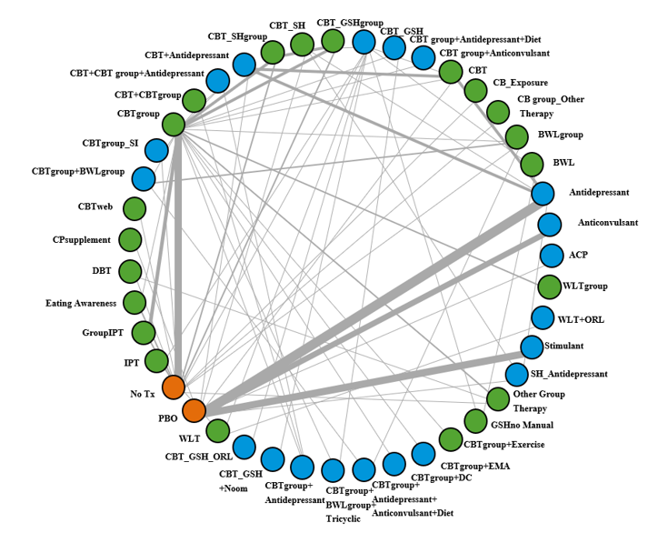
BINGE-EATING DISORDER: Network META-ANALYSIS Diagram of treatments
Notes:
Nodes represent a treatment. Node colors indicate broader groups of the studied interventions. Labels represent included RCTs with direct comparisons for the corresponding edge. Line widths connecting the nodes are proportional to the number of studies that included a specific comparison.
ACP=acamprosate; BWL=behavioral weight loss; CBT=cognitive-behavioral therapy; CPsupplement=chromium picolinate supplement; DBT=dialectical behavior therapy; DC=dietary counseling; EMA=ecological momentary assessment; GSH=guided self-help; IPT=interpersonal psychotherapy; ORL=orlistat; PBO=placebo; SH=self-help; SI=spouse involvement; Tx=treatment; WLT=weight loss treatment

Slide 63
BINGE-EATING DISORDER: CBT and IPT
CBT is the most widely studied of psychotherapies for BED, but IPT also appears to be effective.
Either in individual or group format
Effects of web-based CBT and CBT-based GSH are modest in reducing binge eating but can be used as an initial approach, particularly if other BED treatments are not readily accessible.

Slide 64
BINGE-EATING DISORDERS: MEDICATIONS in adults
For adults with BED who:
prefer medication to CBT or IPT
do not respond to psychotherapy alone
have moderate to severe BED that may benefit from adjunctive pharmacotherapy:
Option 1. Antidepressants
NMA showed some benefit of medication alone or in combination with psychotherapy when compared to placebo or no treatment.
Generally, no weight changes.
Selection of an antidepressant through shared decision-making based on tolerability, side effect profile, and potential for drug-drug interactions.
Tricyclic antidepressants and monoamine oxidase inhibitors are less likely to be used than other antidepressants due to side effect profile.

Slide 65
BINGE-EATING DISORDERS: MEDICATIONS in adults (continued)
Option 2. Lisdexafetamine
Generally, well tolerated.
Initial dosage of 30 mg once daily in the morning, with increases in dosage of 20 mg/week to a therapeutic dosage of 50-70 mg once daily.
No dosage adjustments needed for individuals with hepatic dysfunction, although drug-drug interactions can occur with other medications that are metabolized through CYP2D6 hepatic enzymes.
Lower dosages for individuals with renal impairment (i.e., 50 mg/day maximum dosage for GFR 15 to < 30 mL/minute/1.73 m²; 30 mg/day maximum dosage for GFR < 15 mL/minute/1.73 m² or in end-stage renal disease requiring hemodialysis).
Caution and more frequent monitoring if used in individuals with hypertension or cardiac disease.

Slide 66
BINGE-EATING DISORDER: CLINICAL EXAMPLE
A 45-yo man is referred by his PCP for “eating problems” and consideration for bariatric surgery.
Diagnosed with Type 2 diabetes this year.
He describes being normal weight in high school but increased over years to 285 lbs (he is 5’9”).
Recently has experienced increased knee pain, which has made it hard to work in his job as a bricklayer
He was too embarrassed to tell his PCP about his uncontrollable binges of eating, well past fullness. He says: “I never vomit, but I’ll gorge on ice cream, cookies, chips, and fast food.”

