Slide 1
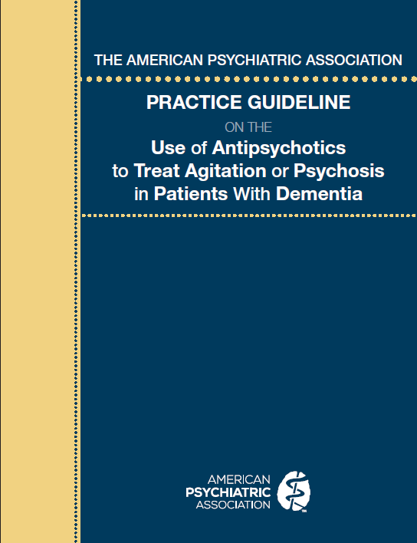
APA Practice Guideline on the Use of Antipsychotics to Treat Agitation or Psychosis in Patients With Dementia
Laura J. Fochtmann, MD, MBI
Distinguished Service Professor, Departments of Psychiatry, Pharmacological Sciences and Biomedical Informatics, Stony Brook University
Medical Editor, Practice Guidelines
American Psychiatric Association
No industry relationships
August 2017

Slide 2
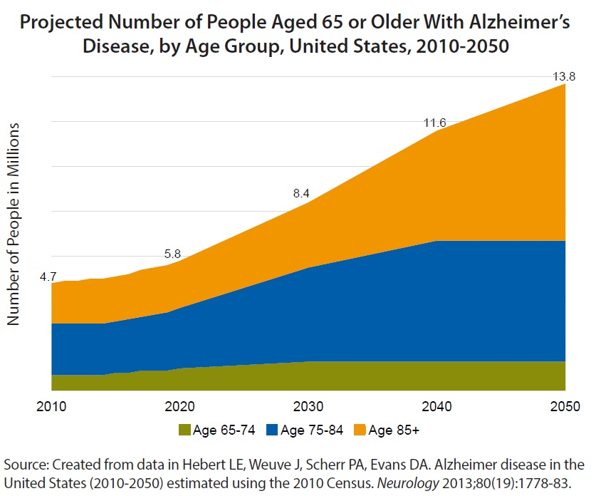
Rationale for choice of topic
Escalating public health impact in that dementia now affects:
  5%–10% of individuals over age 65
  30%–40% of individuals over age 85

Slide 3
Rationale for choice of topic
Agitation and psychotic symptoms are common with dementia
  Affects quality of life for patients and for caregivers
  Increases likelihood of long-term care
Current treatment practices vary suggesting a need for guidance to clinicians
Modest evidence of short-term efficacy of antipsychotic medications, but increasing evidence of associated risks has contributed to increasingly complex decisions for patients, families, and clinicians

Slide 4
goal of guideline
To improve the care of patients with dementia who are experiencing agitation or psychosis, focusing on the judicious use of antipsychotic medications
Guidelines are:
  Assessments of current scientific and clinical information
  Not inclusive of all proper treatments
  Should not serve as a comprehensive standard of care
  Do not account for individual variation
  Not intended to replace independent clinical judgment

Slide 5
Steps in guideline development
Expert survey
Systematic review of available evidence (by AHRQ for this guideline)
Ratings of risk of bias (for individual studies) and strength of research evidence (overall for specific benefits/harms)
Generate guideline statements (recommendations or suggestions) based upon the relative balance of benefits and harms of the assessment or intervention
Modified Delphi approach to achieve group consensus
External review by stakeholders
Approval by Assembly and APA Board of Trustees
Notes:
AHRQ = Agency for Healthcare Research and Quality

Slide 6
Rating the strength of recommendation and research evidence
Strength of recommendation describes the level of confidence that potential benefits of an intervention outweigh potential harms. This level of confidence is informed by available evidence, which includes evidence from clinical trials as well as expert opinion and patient values and preferences.
A “recommendation” (denoted by the numeral 1 after the guideline statement) indicates confidence that the benefits of an intervention (including a specific assessment) clearly outweigh the harms. The statement would apply to the preponderance of patients and most patients would opt for such an intervention.
A “suggestion” (denoted by the numeral 2 after the guideline statement)indicates that the benefits still appear to outweigh the harms but the balance of benefits and harms is less clear-cut and different options may be preferable for some patients.

Slide 7
Rating the strength of recommendation and research evidence
Strength of evidence describes the level of confidence that findings from scientific observation and testing of an intervention reflect a true effect.
  A = High confidence. Further research is very unlikely to change the estimate of effect.
  B = Moderate confidence. Further research may change the estimate of effect and our confidence in it.
  C= Low confidence. Further research is likely to change the estimate of effect and our confidence in it.
Strength of evidence is not the same as the magnitude of the effect as a result of the intervention.

Slide 8
Assessment of Behavioral/Psychological Symptoms of Dementia
Statement 1: APA recommends that patients with dementia be assessed for the type, frequency, severity, pattern, and timing of symptoms. (1C)
Rationale:
  Help in identifying possible contributors to symptoms
  Establish baseline level and pattern of symptoms to assess later treatment response
Implementation:
  Obtain via face-to-face evaluation, review of medical records, and/or history (including from collateral informants)

Slide 9
Assessment (continued)
Common precipitants of agitation or psychosis:
  Hunger, fatigue, pain, too hot, or too cold
  Recent medication change or change in adherence → increased symptoms, side effects, drug interactions
  Physical issues such as infection
  Discomfort or distress related to constipation, incontinence, and other bowel or bladder issues
  Under-stimulation or over-stimulation (e.g., due to boredom, loneliness, noise, clutter or other environmental factors)

Slide 10
Assessment (continued)
Other common contributors:
  Vision or hearing deficits
  Confronted with cognitively challenging situations or demands
  Being assisted with or rushed to complete tasks such as bathing, dressing, or other activities of daily living
  Feeling a loss of privacy, modesty, or other loss of control
  Sensing frustration, anxiety, or other emotional distress of caregivers

Slide 11
Assessment (continued)
Statement 2: APA recommends that patients with dementia be assessed for pain and other potentially modifiable contributors to symptoms as well as for factors, such as sub-type of dementia, that may influence choices of treatment. (1C)
Rationale:
  Help in identifying possible contributors to symptoms, including those that may be modifiable by treatment
  Need to establish diagnosis, which can affect treatment choice (e.g., greater risk of antipsychotic side effects with some types of dementia)

Slide 12
Assessment (continued)
Statement 3: APA recommends that in patients with dementia with agitation or psychosis, response to treatment be assessed with a quantitative measure. (1C)
Rationale:
  Establish baseline level of symptoms to assess later treatment response
  Systematic assessment reduces risk of recall bias
Implementation:
  Can use formal rating scale (e.g., NPI-Q, BPRS, CMAI, MOAS), Likert scale, or log of behaviors

Slide 13
Assessment (continued)
Examples of Rating Scales:
  Neuropsychiatric Inventory Questionnaire (NPI-Q)
    Is symptom present (Y/N)? If yes, rate the symptom severity for patient and level of associated difficulty for caregiver/informant.
Delusions
Hallucinations
Depression/dysphoria
Anxiety
Elation/euphoria
Apathy/indifference
Disinhibition
Irritability/lability
Nighttime behaviors
Appetite/eating behaviors
Motor disturbance/repetitive activities

Slide 14
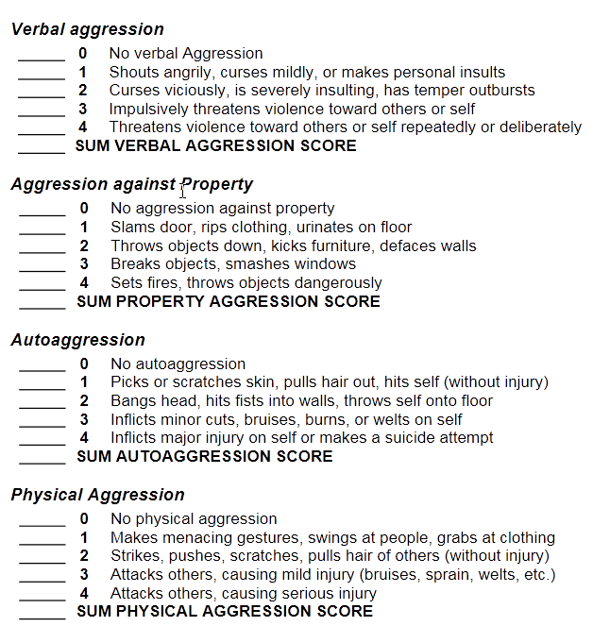
Assessment (continued)
Modified Overt Aggression Scale
Likert scale (for specific symptom)
None (0) Moderate (5) Severe (10)
Log book (incident # and/or severity)
Date No outbursts
Date 2 outbursts, both mild
Date 1 severe outburst
Date 3 severe outbursts
Date No outbursts
Date 2 outbursts, both mild
Date 1 severe outburst
Total 4 mild, 5 severe

Slide 15
Development Of A Comprehensive Treatment Plan
Statement 4: APA recommends that patients with dementia have a comprehensive treatment plan that includes appropriate person-centered nonpharmacological and pharmacological interventions, as indicated. (1C)
Rationale:
  Although evidence for non-pharmacological interventions was not reviewed, harms of such approaches are minimal
  Good clinical practice suggests value of a thoughtfully constructed treatment plan (which can be part of a progress note) that targets specific signs and symptoms as well as unique aspects, values, and preferences of an individual
NOTE: Other pharmacotherapies were not reviewed in this guideline.

Slide 16
Comprehensive Treatment Plan (continued)
Possible non-pharmacological approaches:
  Reduce environmental clutter and noise
  Remove items that could be thrown or that upset patient
  Optimize lighting and give cues to heighten orientation
  Provide eyeglasses, hearing aids, mobility support, etc.
  Consider approaches based on patient history/preferences: hand massage, pet therapy, music listening
  Caregiver education: reflective practice, skills targeting behavioral challenges, and enhancing coping techniques

Slide 17
Assessment of Benefits And Risks Of Antipsychotic Treatment For The Patient
Statement 5: APA recommends that nonemergency antipsychotic medication should only be used for the treatment of agitation or psychosis in patients with dementia when symptoms are severe, dangerous, and/or cause significant distress to the patient. (1B)
Rationale:
  Except in an emergency when acute use of an antipsychotic may be indicated, possible risks of chronic antipsychotic use must be balanced against benefits
  Because harms do exist, use can only be justified if symptom is significant

Slide 18
Assessment of Benefits and Risks (continued)
Statement 6: APA recommends reviewing the clinical response to nonpharmacologic interventions prior to nonemergency use of an antipsychotic medication to treat agitation or psychosis in patients with dementia. (1C)
Rationale:
  Both types of treatments have only modest benefits
  Limited harms of nonpharmacological interventions suggest trying such approaches first, except in emergencies
  Review of response can help identify if nonpharmacological approaches have been tried or whether adjustments to interventions may be indicated prior to antipsychotic use

Slide 19
Assessment Of Benefits And Risks (continued)
Statement 7: APA recommends that, before nonemergency treatment with an antipsychotic is initiated in patients with dementia, the potential risks and benefits from antipsychotic medication be assessed by the clinician and discussed with the patient (if clinically feasible) as well as with the patient’s surrogate decision maker (if relevant), with input from family or others involved with the patient. (1C)
Rationale:
  Such discussions are a part of good clinical practice

Slide 20
Assessment Of Benefits And Risks (continued)
Expert consensus suggests that antipsychotics can be used appropriately in patients with dementia in the context of dangerous agitation or psychosis to:
  improve patient's quality of life
  reduce patient distress
  reduce the risk of violence
  decrease caregiver burden
Randomized placebo-controlled trials suggest some efficacy for risperidone in treating psychosis and for risperidone, olanzapine, and aripiprazole in agitation

Slide 21
Assessment Of Benefits And Risks (continued)
Effect size | Agitation | Psychosis | Overall BPSD
Aripiprazole | Small | NS | Small
Olanzapine | Very small | NS | Very small
Quetiapine | NS | NS | NS
Risperidone | Small | Small | Very small
SGAs Overall | Small | Very small | Very small
Haloperidol | No diff from SGAs | Indeterminate | No diff from SGAs
Confidence in the findings based on quality of the research evidence
High confidence |  | Moderate |  | Low confidence |  | Insufficient data
BPSD = Behavioral and Psychological Symptoms of Dementia
ADAPTED FROM: Maglione et al. Off-Label Use of Atypical Antipsychotics: An Update. Rockville (MD): AHRQ (US); 2011. PMID: 22132426. http://www.ncbi.nlm.nih.gov/books/NBK66081/

Slide 22
Assessment Of Benefits And Risks (continued)
Information from quetiapine trials was insufficient to identify benefits
No data on benefits of asenapine, brexpiprazole, cariprazine, clozapine, iloperidone, lurasidone, paliperidone, or ziprasidone in individuals with dementia
Data from discontinuation trials suggest a small overall benefit to staying on antipsychotic as compared to changing to placebo

Slide 23
Assessment Of Benefits And Risks (continued)
Consistent evidence, predominantly from large observational studies, indicates antipsychotic medications are associated with clinically significant adverse effects, including mortality, among individuals with dementia
Risk of mortality with SGAs in individuals with dementia was greater than the risk with placebo
Risk of mortality with SGAs was generally less than the risk with FGAs, although most of the latter studies used haloperidol

Slide 24
Assessment Of Benefits And Risks (continued)
Adverse effect | Overall strength of research evidence
Mortality | High for SGAs vs. placebo and FGAs vs. SGAs Moderate for haloperidol vs. risperidone
Sedation/fatigue | Moderate
EPS | Moderate
Weight gain | Moderate
Stroke | Low
Cardio & pulmonary | Low
Cognitive changes | Low
Falls/hip fracture | Low
Diabetes | Low
Urinary symptoms | Low
ADAPTED FROM: Maglione et al. Off-Label Use of Atypical Antipsychotics: An Update. Rockville (MD): AHRQ (US); 2011. PMID: 22132426. http://www.ncbi.nlm.nih.gov/books/NBK66081/

Slide 25
Assessment Of Benefits And Risks (continued)
NNH | Gait | EPS | Fatigue | Sedation | Cardio-vascular | Stroke
Aripiprazole | -- | -- | 22 | 16 | -- | --
Olanzapine | 21 | 10 | 34 | 9 | 48 | --
Quetiapine | -- | -- | 34 | 8 | -- | --
Risperidone | 33 | 20 | 34 | 10 | 34 | 53
Number needed to harm (NNH) not calculated for many cells due to non-significant effects or insufficient sample sizes or clinical trial data.
ADAPTED FROM: Maglione et al. Off-Label Use of Atypical Antipsychotics: An Update. Rockville (MD): AHRQ (US); 2011. PMID: 22132426. http://www.ncbi.nlm.nih.gov/books/NBK66081/

Slide 26
Assessment Of Benefits And Risks (continued)
There may be differences in mortality risk between individual second generation antipsychotic agents, but confidence intervals are overlapping and effects are dose dependent
Samples with aripiprazole were small
No information about the harms of asenapine, brexpiprazole, cariprazine, clozapine, iloperidone, lurasidone, paliperidone, or ziprasidone in individuals with dementia

Slide 27
Considerations in Medication Selection
What benefits did specific medications show for the target symptom (e.g., agitation, psychosis) in clinical trials?
What is the side effect profile of the medication?
Does the patient have co-occurring physical conditions that would influence medication tolerability or potential for side effects?
Are there relevant pharmacokinetic considerations (e.g., drug interactions, active metabolites)?

Slide 28
Considerations in Medication Selection
What formulations of the medication are available that may assist with patient adherence?
Are there any barriers to use of a specific medication (e.g., regulatory stipulations, cost considerations, formulary coverage, preauthorization requirements)?
Does the patient or family have a stated preference for a specific medication?

Slide 29
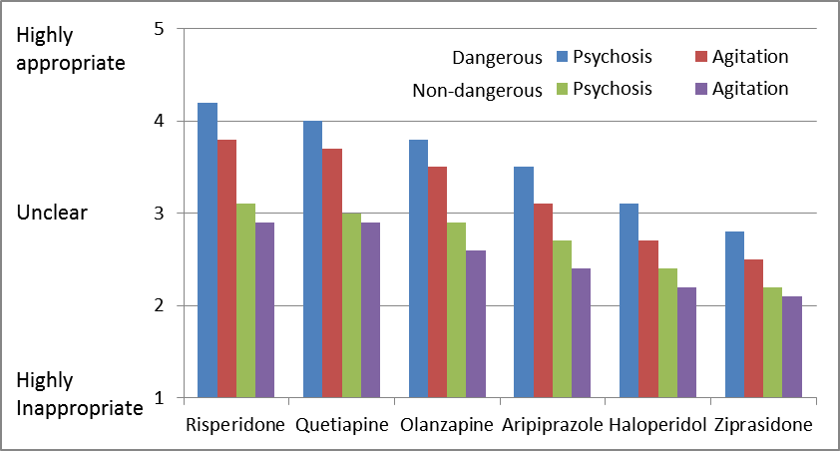
Antipsychotic Appropriateness with Persistent/Repeated Symptoms
ADAPTED FROM: Expert Survey Data. See Appendix B in: American Psychiatric Association: Practice Guideline on the Use of Antipsychotics to Treat Agitation or Psychosis in Patients With Dementia. Arlington, VA, APA, 2016.

Slide 30
Considerations in Medication Selection
Factors that experts noted may influence their prescribing in individuals with dementia:
  Aripiprazole: Long half-life, potential for drug-drug interactions, partial agonist mechanism of action, greater rates of akathisia
  Olanzapine: Greater likelihood of anticholinergic effects, sedation, metabolic effects, and weight gain
  Risperidone: Greater likelihood of extrapyramidal symptoms and hyperprolactinemia
  Ziprasidone: Changes in absorption with food and greater likelihood of QTc prolongation

Slide 31
Considerations in Medication Selection
Statement 14: APA recommends that in the absence of delirium, if nonemergency antipsychotic medication treatment is indicated, haloperidol should not be used as a first-line agent. (1B)
Rationale:
  Comparison data showed no superiority of haloperidol compared to SGAs in treating agitation or psychosis
  Some harms appeared to have a greater likelihood of occurrence with haloperidol vs. SGAs (mortality, EPS)
  Parenteral availability of haloperidol may still warrant short-term use in emergencies

Slide 32
Considerations in Medication Selection
Statement 15: APA recommends that in patients with dementia with agitation or psychosis, a long-acting injectable antipsychotic medication should not be utilized unless it is otherwise indicated for a co-occurring chronic psychotic disorder. (1B)
Rationale:
  Given potential harms of antipsychotic medication and pharmacokinetic factors in older patients that may further prolong the duration of action, the risks of long-acting agents seemed greater than benefits for most patients

Slide 33
Overview: Antipsychotic Use
Non-pharmacological approaches ➔ inadequate response
Review of options ➔ Decision to try an antipsychotic
Begin at low dose and titrate slowly
Taper, discontinue, and discuss other options
No response after 4 weeks
Significant side effect
Good clinical response
Review risk/benefits
Assess at 4 months; taper attempt recommended

Slide 34
Dosing, Duration, And Monitoring of Antipsychotic Treatment
Statement 8: APA recommends that if a risk/benefit assessment favors the use of an antipsychotic for behavioral/psychological symptoms in patients with dementia, treatment should be initiated at a low dose to be titrated up to the minimum effective dose as tolerated. (1B)
Rationale:
  Good clinical practice particularly in older individuals, rooted in pharmacokinetic considerations
    Metabolism, excretion, interactions with other medications → longer time to reach steady state levels and greater issues with tolerability

Slide 35
Dosing, Duration, and Monitoring
Statement 9: APA recommends that if a patient with dementia experiences a clinically significant side effect of antipsychotic treatment, the potential risks and benefits of antipsychotic medication should be reviewed by the clinician to determine if tapering and discontinuing of the medication is indicated. (1C)
Rationale:
  Such a review is part of good clinical practice although often done informally
  Occurrence of a significant side effect could change prior benefit/risk considerations for antipsychotic treatment

Slide 36
Dosing, Duration, and Monitoring
Statement 10: APA recommends that in patients with dementia with agitation or psychosis, if there is no clinically significant response after a 4-week trial of an adequate dose of an antipsychotic drug, the medication should be tapered and withdrawn. (1B)
Rationale:
  In the absence of benefit, exposure to ongoing risks of antipsychotic would be unwarranted

Slide 37
Dosing, Duration, And Monitoring
Statement 11: APA recommends that in a patient who has shown a positive response to treatment, decision-making about possible tapering of antipsychotic medication should be accompanied by a discussion with the patient (if clinically feasible) as well as with the patient’s surrogate decision maker (if relevant) with input from family or others involved with the patient. The aim of such a discussion is to elicit their preferences and concerns and to review the initial goals, observed benefits and side effects of antipsychotic treatment, and potential risks of continued exposure to antipsychotics, as well as past experience with antipsychotic medication trials and tapering attempts. (1C)

Slide 38
Dosing, Duration, and Monitoring
Statement 12: APA recommends that in patients with dementia who show adequate response of behavioral/psychological symptoms to treatment with an antipsychotic drug, an attempt to taper and withdraw the drug should be made within 4 months of initiation, unless the patient experienced a recurrence of symptoms with prior attempts of tapering of antipsychotic medication. (1C)
Rationale:
  A substantial fraction of individuals can have antipsychotics tapered without recurrent symptoms, reducing potential harms of medication

Slide 39
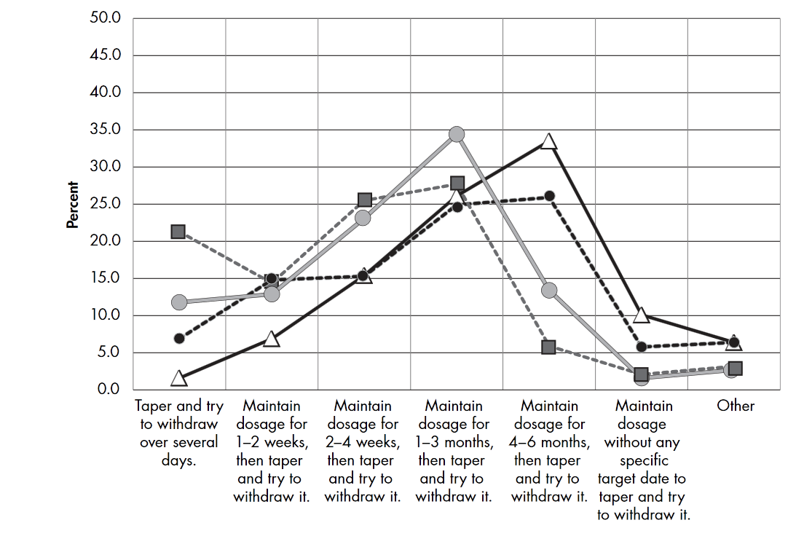
Treatment duration: Expert survey
Source: Expert Survey Data. See Appendix B in: American Psychiatric Association: Practice Guideline on the Use of Antipsychotics to Treat Agitation or Psychosis in Patients With Dementia. Arlington, VA, APA, 2016.

Slide 40
Dosing, Duration, and Monitoring
Statement 13: APA recommends that in patients with dementia whose antipsychotic medication is being tapered, assessment of symptoms should occur at least monthly during the taper and for at least 4 months after medication discontinuation to identify signs of recurrence and trigger a reassessment of the benefits and risks of antipsychotic treatment. (1C)
Rationale:
  Careful monitoring for recurrence could minimize potential risks of tapering and allow early intervention/resumption

Slide 41
Additional resources
Full guideline text available for free: http://psychiatryonline.org/doi/book/10.1176/appi.books.9780890426807
To purchase a hard copy of the guideline: https://www.appi.org/Course/Book/Subscription/JournalSubscription/id-3476/The_American_Psychiatric_Association_Practice_Guideline_on_the_Use_of_Antipsychotics_to_Treat_Agitation_or_Psychosis_in_Patients_With_Dementia
CME course (half price for residents): http://education.psychiatry.org/Users/ProductDetails.aspx?ActivityID=3584&_ga=2.112758210.772612044.1502717244-631082871.1502398049
  In this interactive online course, the case of a patient with dementia is presented with examples of how the guideline recommendations would be integrated into practice.

Slide 42
Acknowledgements
Guideline Writing Group
Victor Reus, MD, Chair
Laura Fochtmann, MD, MBI, Vice-Chair
A. Evan Eyler, MD, MPH
Donald M. Hilty, MD
Marcela Horvitz-Lennon, MD, MPH
Michael D. Jibson, PhD, MD
Oscar L. Lopez, MD
Jane Mahoney, PhD, RN
Jagoda Pasic, MD, PhD
Zaldy S. Tan, MD, MPH
Cheryl D. Wills, MD
Systematic Review Group
Laura Fochtmann, MD, MBI
Richard Rhoads, MD
Joel Yager, MD
APA Staff
Robert Kunkle
Seung-Hee Hong
Karen Kanefield
Kristin Kroeger Ptakowski
Committee on Practice Guidelines
Michael Vergare, MD, Chair
Dan Anzia, MD, Vice-chair

